Slide 1
03-Create and consume Data

Slide 2
What you will learn in this course 🧐🧐
Let's dive right into the code now. Once you have a cluster ready to go, you can start producing and consuming data. In this course, we will show you:
How to produce and consume data using Python scripts
How to produce and consume data using Kafka Connect

Slide 3
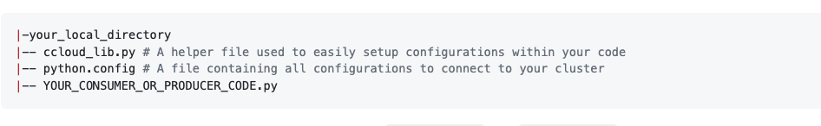
Setup your environment 🧰
Requirements
Make sure your cluster is setup (as show in Kafka Basics course)
Make sure you have an API Key available
Make sure Docker is installed on your local machine
Global Setup
Before diving into the code, there is a certain structure that both your Producer and Consumer needs to follow. You will always need to have at least this structure within your local directory:

Slide 4
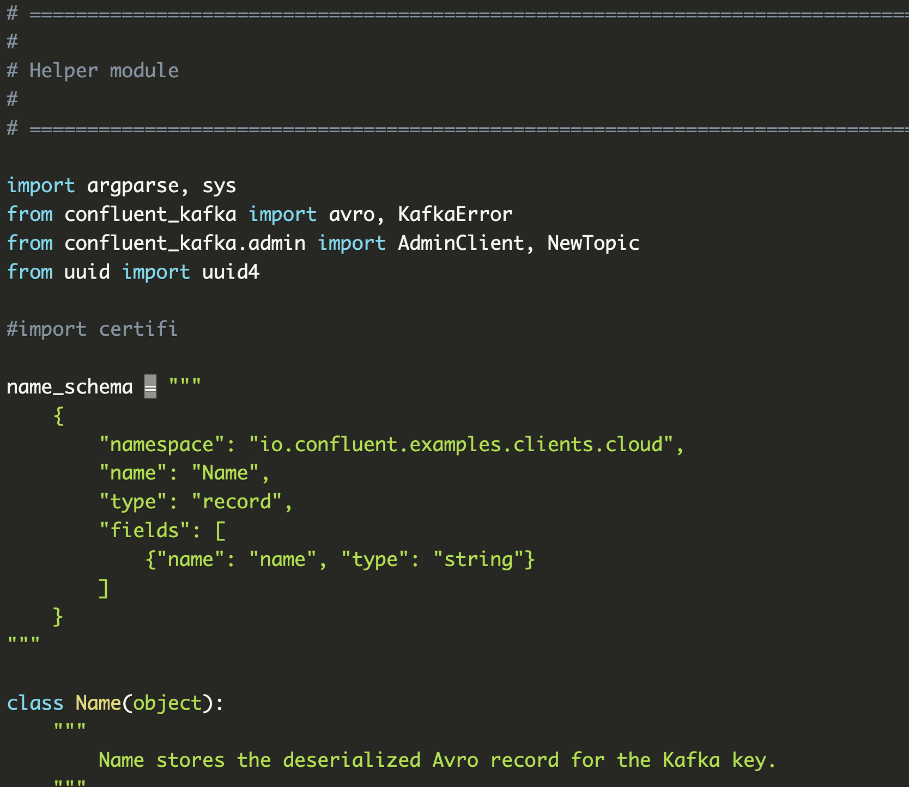
Setup your environment 🧰
To get ccloud_lib.py, you can simply:
download its content 👉 here
Download its content right from the "resources" section of this course
The content of the file should look something like this:

Slide 5
Setup your environment 🧰
This file is what we call a helper. This means that we will be able to import all its modules just like we would do with more popular libraries like pandas or numpy.
NOTE
You don't really need to memorise everything this code is doing. Feel free to have a look but that is not core for this course

Slide 6
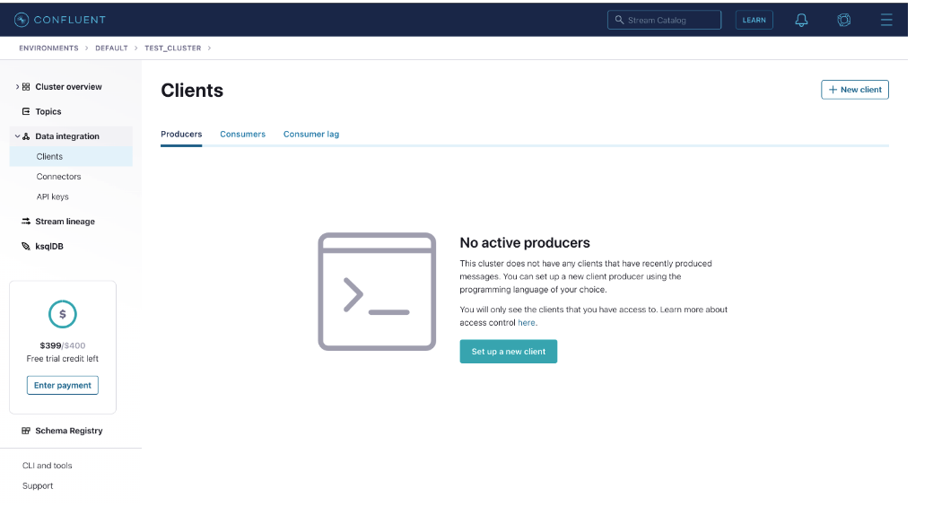
Setup your environment 🧰
Finally, let's retrieve your python.config file. To do so:
Go into your Confluent Cloud account
Go into Data Integrations > Clients and click on Setup a new client

Slide 7
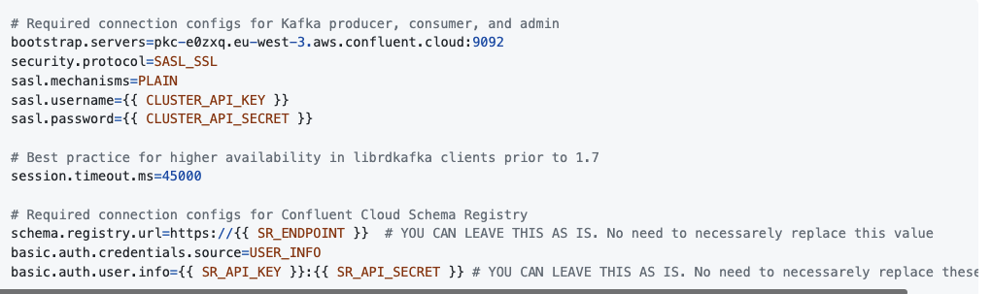
Setup your environment 🧰
Select Python and you should be prompted to a window with this sample code:
Copy/Paste this code into a file called python.config
Replace {{ CLUSTER_API_KEY }} and {{ CLUSTER_API_SECRET }} by your own credentials that you already created in Kafka Basics course. (You can also create a new one on the fly if you've lost your API key 😉)

Slide 8
Installation on your local machine
Back on your local machine, you will have a few installations to make. To facilite this process, we built an Docker image for you that you can directly run:
docker run -it -v "$(pwd):/home/app" jedha/confluent-image bash
This will prompt you to a linux terminal inside a Docker container.
Note If you want to directly install confluent cloud on your machine (which we don't advise as you might get bugs), you will need to install:
confluent-kafka
requests
certifi
confluent-kafka[avro,json,protobuf]>=1.4.2
You can use pip to do so. :::
And now, you are all set! 🎉

Slide 9
Create your first Producer
Get started script
Let's now right some code 🤗 We will start by creating a producer that will write data to a Topic (that we haven't created yet). Let's do it:
Run your container docker run -it -v "$(pwd):/home/app" jedha/confluent-image
There is a bind mount volume attached to it, meaning you can code directly inside the local directory of your machine where you run the command.

Slide 10
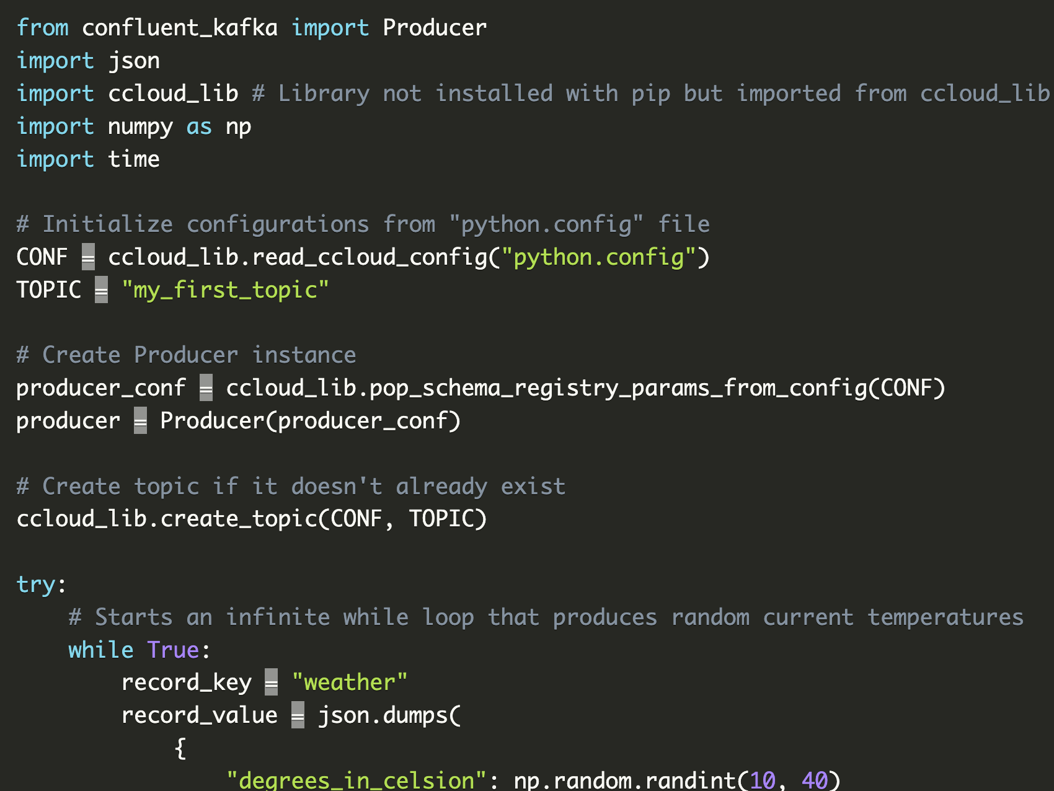
Create your first Producer
Create a file called producer.py with the following content:

Slide 11
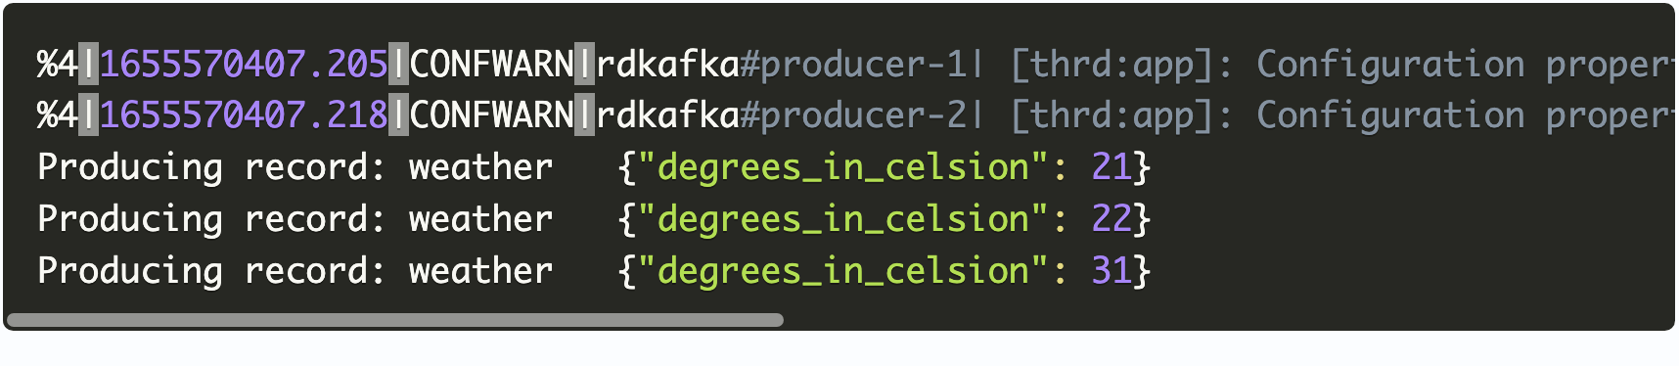
Create your first Producer
Get started script
Let's now right some code 🤗 We will start by creating a producer that will write data to a Topic (that we haven't created yet). Let's do it:
Run your container docker run -it -v "$(pwd):/home/app" jedha/confluent-image
There is a bind mount volume attached to it, meaning you can code directly inside the local directory of your machine where you run the command.
Simply run: python producer.py within your container to run the script. You should see the following output:

Slide 12
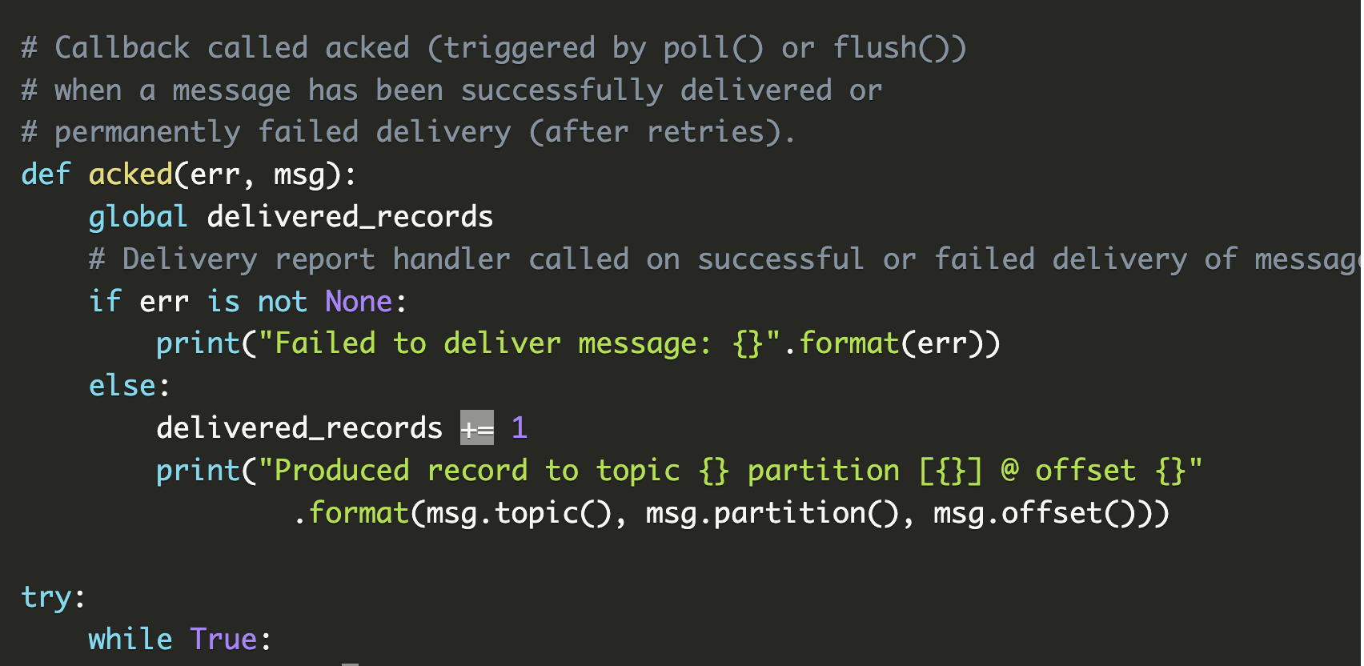
Monitor your producer work
The best way to monitor your producer script is to check out logs! To provide interesting information like successfully or unsuccessfully produced message, you will need to create a callback that you will insert in your .produce() method that will be called once you'll call .poll() or .flush() method.

Slide 13
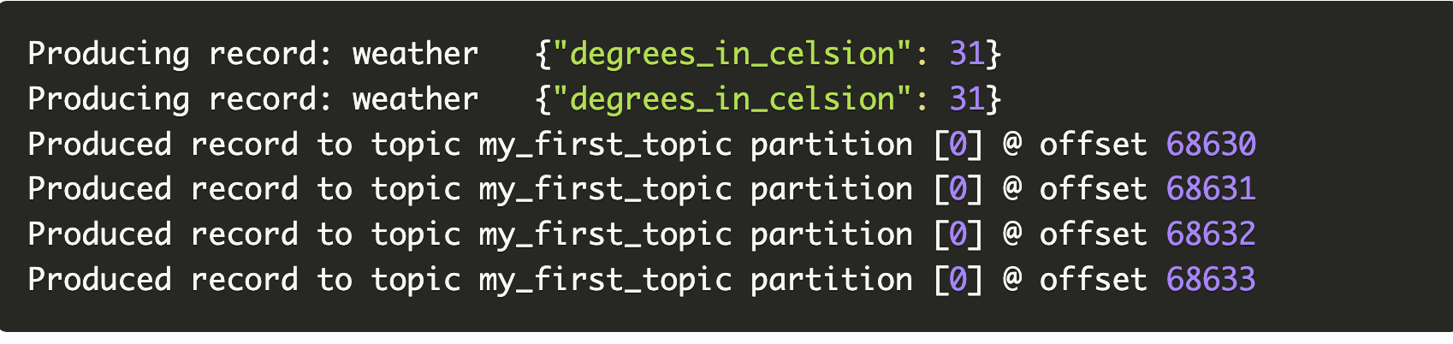
Monitor your producer work
You should see additionnal logs like this:
.

Slide 14
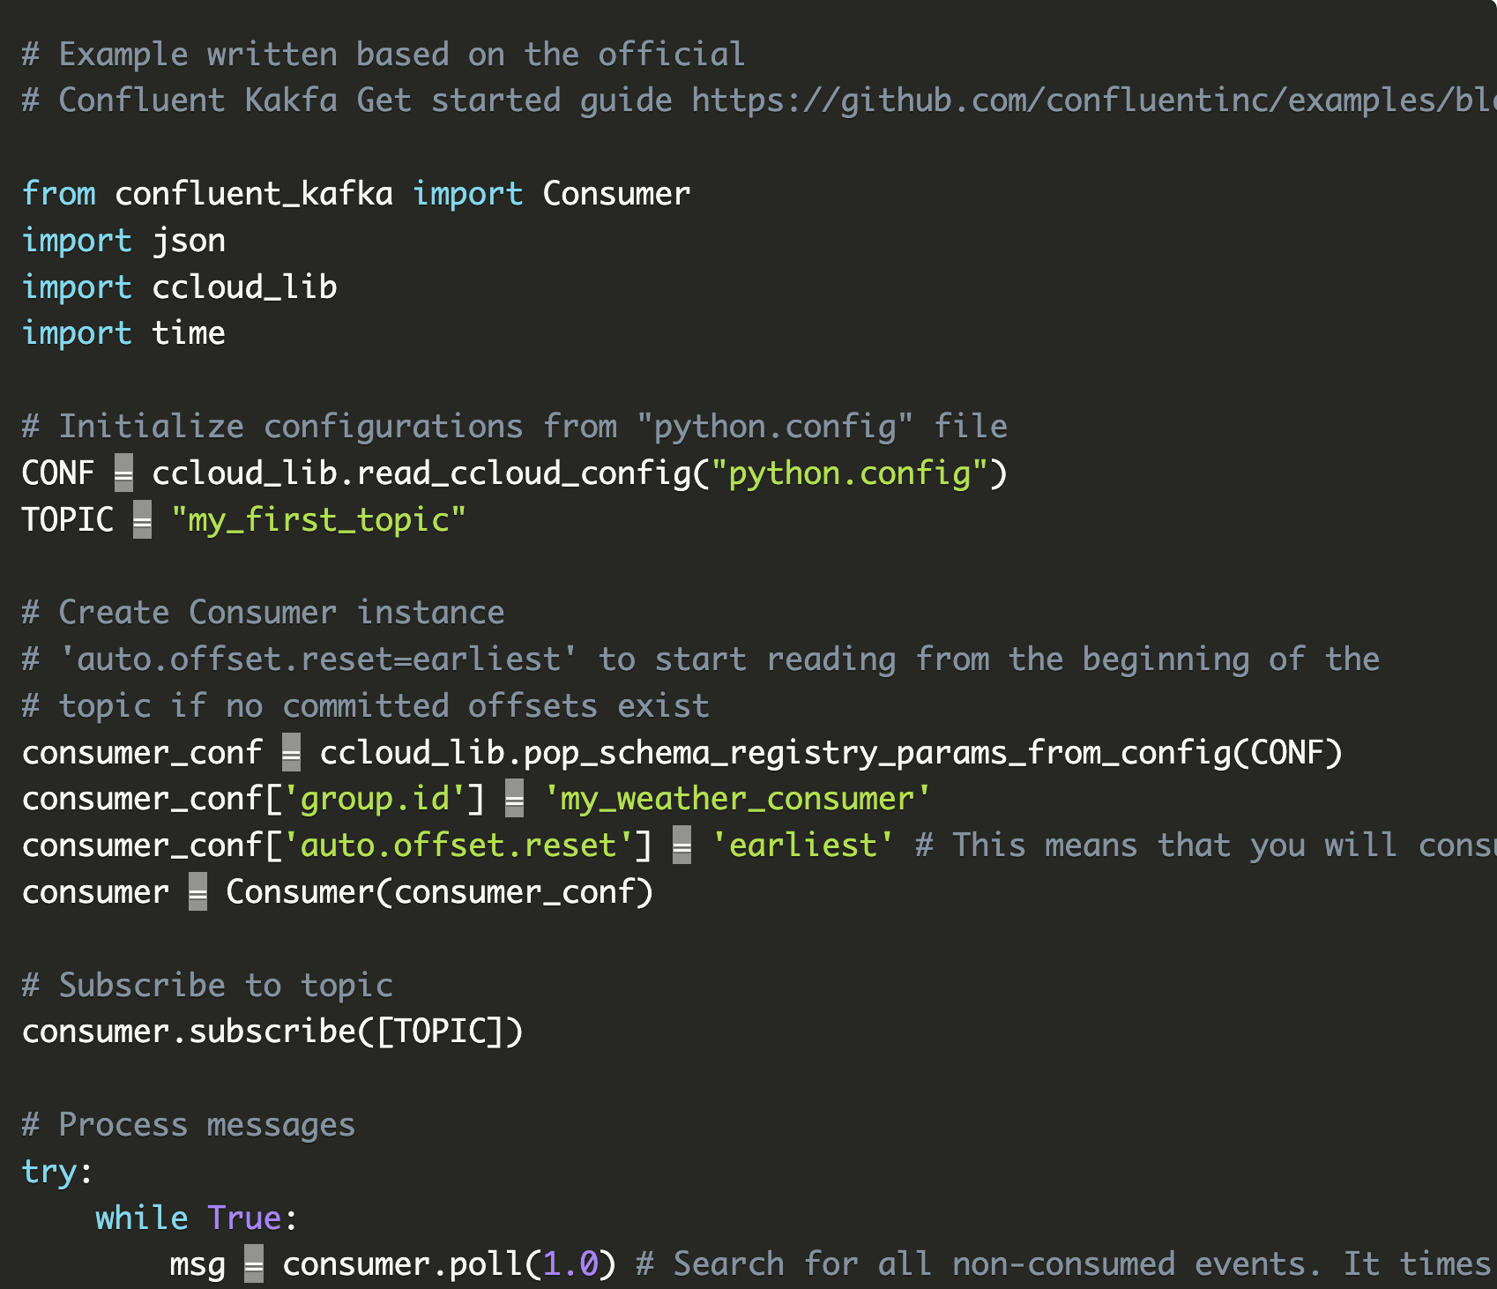
Consumer
Good news, consumers works almost the same way as producers 🥳 You will simply need to replace Producer by Consumer

Slide 15
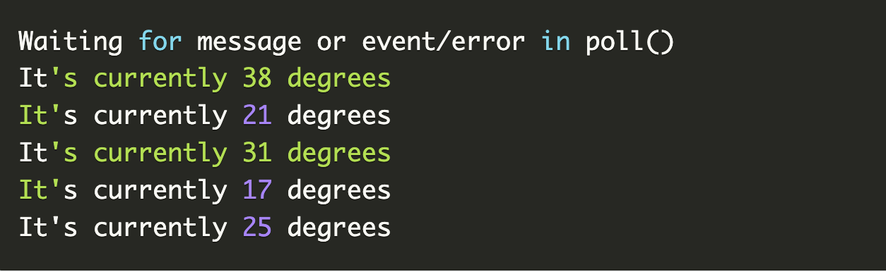
Consumer
You should see the following output:

